Slide 1


CSE2067 - Web Technology
Department of Computer Science Engineering
School of Engineering

Slide 2
Module I - Syllabus
Introduction to XHTML [L-10hrs.,P-10hrs.]
Basics: Web, WWW, Web browsers, Web servers, Internet.
XHTML: Origins and Evolution of HTML and XHTML: Basic Syntax, Standard XHTML Document Structure, Basic Text Markup, Images, Hypertext Links, Lists, Tables, Forms, Frames, Syntactic Differences between HTML and XHTML

Slide 3
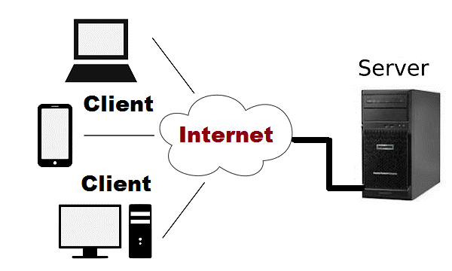
Web Essentials:
Client and Server
The Web is a client/server application: Web browsers are clients which send requests to Web servers, which send responses back.

Slide 4
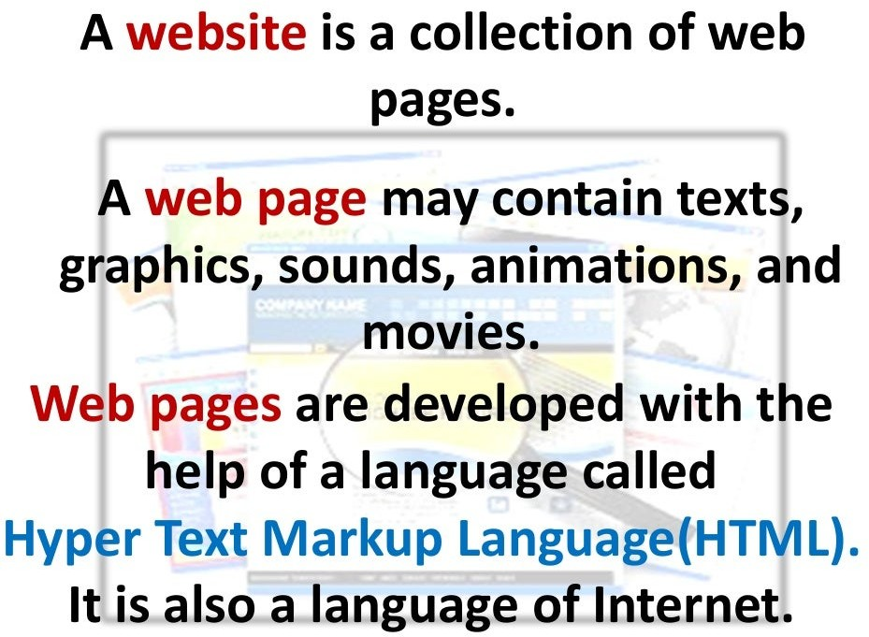
Web Essentials:

Slide 5

Web Essentials:
Web server: Software that delivers Web pages and other documents to browsers using the HTTP protocol
URL: Uniform Resource Locator, the unique address which identifies a resource on the Internet for routing purposes.

Slide 6
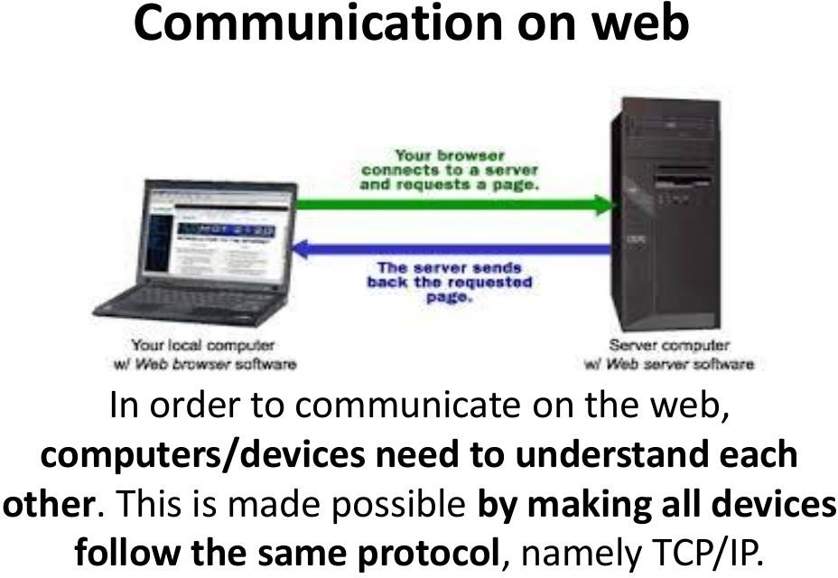
Web Essentials:

Slide 7
Web Essentials:
The Internet:
• Medium for communication and interaction in inter connected network.
• Makes information constantly and instantly available to anyone with a connection.
Web Browsers:
• User agent for Web is called a browser:
o Internet Explorer
o Firefox
`

Slide 8
Introduction to Internet
History of the Internet
Internet evolved in 1969 and evolved many changes in several technologies and Infrastructural levels.
Internet was started by ARPANET (Advanced Research Project Agency Network), developed by United States.
Department of Defence (DoD) for communication among different government bodies, initially with four nodes.
In 1972, invented TCP/IP protocols, DNS, WWW, browsers scripting languages.
Internet is used as a medium to publish and access the information

Slide 9
Introduction to Internet
In 1985, The Nation Science Foundation(NSFNET) was composed of multiple regional networks and peer networks
In 1986, the NSFNET created a three-tiered network architecture.
In 1988, updated the links to make it faster
In 1990, Merit, IBM, and MCI started a new organization known as Advanced Network and Services (ANS).
By 1991, data traffic had increased tremendously, which necessitated upgrading the NSFNET's backbone network service.

Slide 10
Introduction to Internet
What Is the Internet?
The Internet is a huge collection of computers connected in a communications network.
In fact, some of the devices connected to the Internet—such as plotters and printers—are not computers at all.
Transmission Control Protocol/Internet Protocol (TCP/IP)became the standard for computer network connections in 1982.
It can be used directly to allow a program on one computer to communicate with a program on another computer via the Internet.
So, the Internet is actually a “network of networks”

Slide 11
Introduction to Internet
Internet Protocol Addresses
An IP address is a unique address that identifies a device on the internet or a local network. IP stands for "Internet Protocol" .
IPv4 addresses are expressed as a set of four numbers — an example address might be 192.158.1.38. Each number in the set can range from 0 to 255. So, the full IP addressing range goes from 0.0.0.0 to 255.255.255.255.
In late 1998, a new IP standard, IPv6, was approved, The address size IPv4 32 bits and IPv6128 bits
The following are examples of valid IPv6 (normal) addresses:
2001:db8:3333:4444:5555:6666:7777:8888. 2001:db8:3333:4444:CCCC:DDDD:EEEE:FFFF.

Slide 12
Introduction to Internet
Hardware Requirements for Internet connection:
Modem is used to connect Internet through Telephone connection.
NIC- Network Interface Card(wired/ wireless) facility is the most important hardware required to connect Internet. For example, the Laptop can be connected Internet through the wired/wireless.
Dongle is used to connect the Internet using cellular network
Wi-Fi router or Hotspot is used to connect the Internet using wireless network
Electronic device which supports cellular network
Internet Connectivity such as Dial-up connection, ISDN, DSL, Cable TV, wired and wireless (Cellular) Network.

Slide 13
Introduction to Internet
Software Requirements for Internet connection:
The operating system should support TCP (Transfer Control Protocol) / IP (Internet Protocol), SMTP (Simple Mail Transfer Protocol), FTP (File Transfer Protocol), HTTP (Hyper Text Transfer Protocol) and HTTPS (Hyper Text Transfer Protocol Secured) protocols.
Browsers and other Internet clients access to the web applications such as Outlook, Gmail, Whatsapp, Facebook, Twitter and etc.

Slide 14
Introduction to Internet
Domain Names
A domain name (often simply called a domain) is an easy-to-remember name that’s associated with a physical IP address on the Internet.
It’s the unique name that appears after the @ sign in email addresses, and after www. in web addresses.
For instance, the domain name example.com might translate to the physical address 198.102.434.8.
Other examples of domain names are google.com and wikipedia.org.
Using a domain name to identify a location on the Internet rather than the numeric IP address makes it much easier to remember and type web addresses.

Slide 15
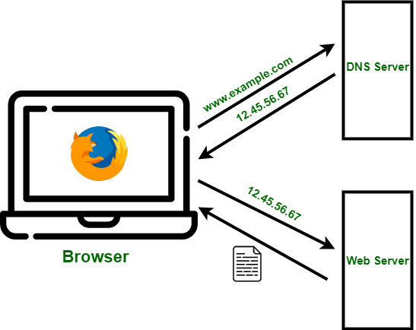
Introduction to Internet
Domain Name System (DNS)
DNS is a directory service that provides a mapping between the name of a host on the network and its numerical address.
DNS is a service that translates the domain name into IP addresses.
This allows the users of networks to utilize user-friendly names when looking for other hosts instead of remembering the IP addresses.

Slide 16
The World Wide Web
Origins
In 1989, a small group of people led by Tim Berners-Lee at CERN (Conseil Européen pour la Recherche Nucléaire, or European Organization for Particle Physics) proposed a new protocol for the Internet.
The intent of this new system, which the group named the World Wide Web, was to allow scientists around the world to use the Internet to exchange documents describing their work.
The proposed new system was designed to allow a user anywhere on the Internet to search for and retrieve documents from databases on any number of different document-serving computers connected to the Internet

Slide 17
The World Wide Web
Origins
Later the system used hypertext, which is text with embedded links to text in other documents to allow nonsequential browsing of textual material.
The idea of hypertext had been developed earlier and had appeared in Xerox’s NoteCards and Apple’s HyperCard in the mid-1980s.
Later World Wide Web simply as “the Web.”
Later include images, sound recordings, or other kinds of media to access data / information. When a document contains nontextual information, it is called hypermedia.

Slide 18
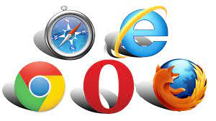
Web Browsers
When two computers communicate over some network, in many cases one acts as a client and server.
The client initiates the communication, which is often a request for information stored on the server, which then sends that information back to the client.
The Web, as well as many other systems, operates in this client-server configuration.
Documents provided by servers on the Web are requested by browsers, which are programs running on client machines. They are called browsers because they allow the user to browse the resources available on servers.

Slide 19
Web Browsers
A web browser takes you anywhere on the internet.
It retrieves information from other parts of the web and displays it on your desktop or mobile device.
The information is transferred using the Hypertext Transfer Protocol, which defines how text, images and video are transmitted on the web.
The most commonly used browsers are Microsoft Internet Explorer (IE), Firefox, and Netscape Navigator, as well as Opera and Apple’s Safari.

Slide 20
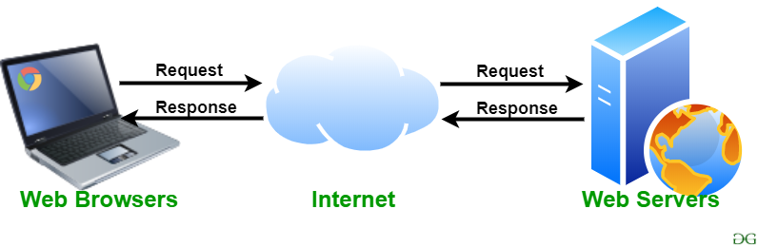
The World Wide Web
Web Servers
Web servers are programs that provide documents to requesting browsers.
Servers are slave programs: They act only when requests are made to them by browsers running on other computers on the Internet.
The most commonly used Web servers are Apache, which has been implemented for a variety of computer platforms, and Microsoft’s Internet Information Server (IIS),

Slide 21
The World Wide Web
Server Types
Web servers. A web server is a computer servicing HTTP requests. This typically refers to a computer running web server software such as Apache or Microsoft IIS (Internet Information Services).
Application servers. An application server is a computer that hosts and executes web applications, which may be created in PHP, ASP.NET, Ruby on Rails, or some other web development technology.
Database servers. A database server is a computer that is devoted to running a Database Management System (DBMS), such as MySQL, Oracle, or SQL Server, that is being used by web applications

Slide 22
The World Wide Web
Server Types
Mail servers. A mail server is a computer creating and satisfying mail requests, typically using the Simple Mail Transfer Protocol (SMTP).
Media servers. A media server (also called a streaming server) is a special type of server dedicated to servicing requests for images and videos. It may run special software that allows video content to be streamed to clients

Slide 23
The Web
Web Basics
A web page is nothing more than an HTML (HyperText Markup Language) document (with the extension .html or .htm) that describes to a web browser the document’s content and structure.
Hyperlinks - HTML documents normally contain hyperlinks, which, when clicked, load a specified web document.
Both images and text may be hyperlinked. When the mouse pointer hovers over a hyperlink, the default arrow pointer changes into a hand with the index finger pointing upward.
Often hyperlinked text appears underlined and in a different color from regular text in a web page

Slide 24
The Web
URL Formats
The first part of the URL is the protocol that we are using.
The domain identifies the server from which we are requesting resources. Since the DNS system is case insensitive, this part of the URL is case insensitive. Alternatively, an IP address can be used for the domain

Slide 25
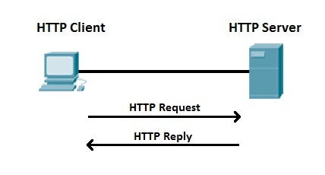
The Web
The Hypertext Transfer Protocol
Web communications transactions use the same protocol: the Hypertext Transfer Protocol (HTTP).
HTTP consists of two phases: the request and the response.
Each HTTP communication (request or response) between a browser and a Web server consists of two parts: a header and a body.
The header contains information about the communication The body contains the data of the communication if there is any.
The HTTP establishes a TCP connection on port 80 (by default).

Slide 26
The Web
Hypertext Transfer Protocol
The HTTP protocol defines several different types of requests, each with a different intent and characteristics.
The most common requests are the GET and POST request.
GET request
In this request one is asking for a resource located at a specified URL to be retrieved. Whenever you click on a link, type in a URL in your browser, or click on a book mark, you are usually making a GET request
POST request
This method is normally used to transmit data to the server using an HTML form. A post request sends form data as part of the HTTP message, not as part of the URL. since the data is not transmitted in the URL, it is seen to be a safer way of transmitting data.

Slide 27
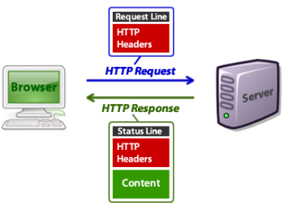
The Web
Hypertext Transfer Protocol
Response codes are integer values returned by the server as part of the response header. These codes describe the state of the request, including whether it was successful, had errors, requires permission, and more.

Slide 28
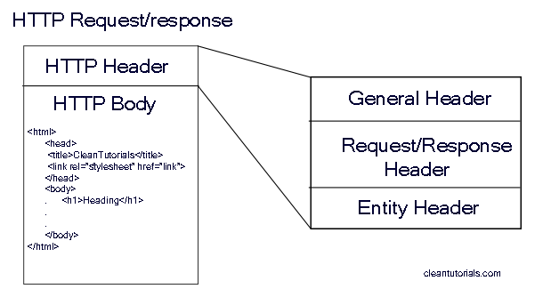
The Web
Hypertext Transfer Protocol
The Request Phase - The general form of an HTTP request is as follows:
Header fields
Message body

Slide 29
The Web
Hypertext Transfer Protocol
The Request / Response Phase - The general form of an HTTP request is as follows:
Header fields
Message body

Slide 30
The Web
website (also written as web site) is a collection of web pages and related content that is identified by a common domain name and published on at least one web server. Examples of notable websites are Google, Facebook, Amazon, and Wikipedia.
Static Websites versus Dynamic Websites
Static website consists only of HTML pages that look identical for all users at all times.
Dynamic website page content is being created at run time by a program created by a programmer; this page content can vary from user to user

Slide 31
The Web
Hypertext Transfer Protocol
The HTTP protocol defines several different types of requests, each with a different intent and characteristics.
The most common requests are the GET and POST request.
GET request
In this request one is asking for a resource located at a specified URL to be retrieved. Whenever you click on a link, type in a URL in your browser, or click on a book mark, you are usually making a GET request
POST request
This method is normally used to transmit data to the server using an HTML form. A post request sends form data as part of the HTTP message, not as part of the URL. since the data is not transmitted in the URL, it is seen to be a safer way of transmitting data.

Slide 32
The Web
Client-Side Scripting versus Server-Side Scripting
Client-side scripting:- method of interacting with web browser
Client-side scripting with JavaScript can be used to validate user input, to interact with the browser, to enhance web pages, and to add client/server communication between a browser and a web server.
Server-side scripts:- allow user to interact with server

Slide 33
The Web
The Web Programmer’s Toolbox
common tools used in Web programming—some are programming languages
XHTML
XML
JavaScript
Flash
PHP
Ajax
.NET
Ruby
Rails

Slide 34


